Slide 1
Partitioning (continued)

Slide 2
Fiduccia-Mattheyses (FM) Algorithm
•Modified version of KL
•A single vertex is moved across the cut in a single move
–Unbalanced partitions
•Vertices are weighted
•Concept of cutsize extended to hypergraphs
•Special data structure to improve time complexity
–(Main feature)
•Can be extended to multi-way partitioning

Slide 3
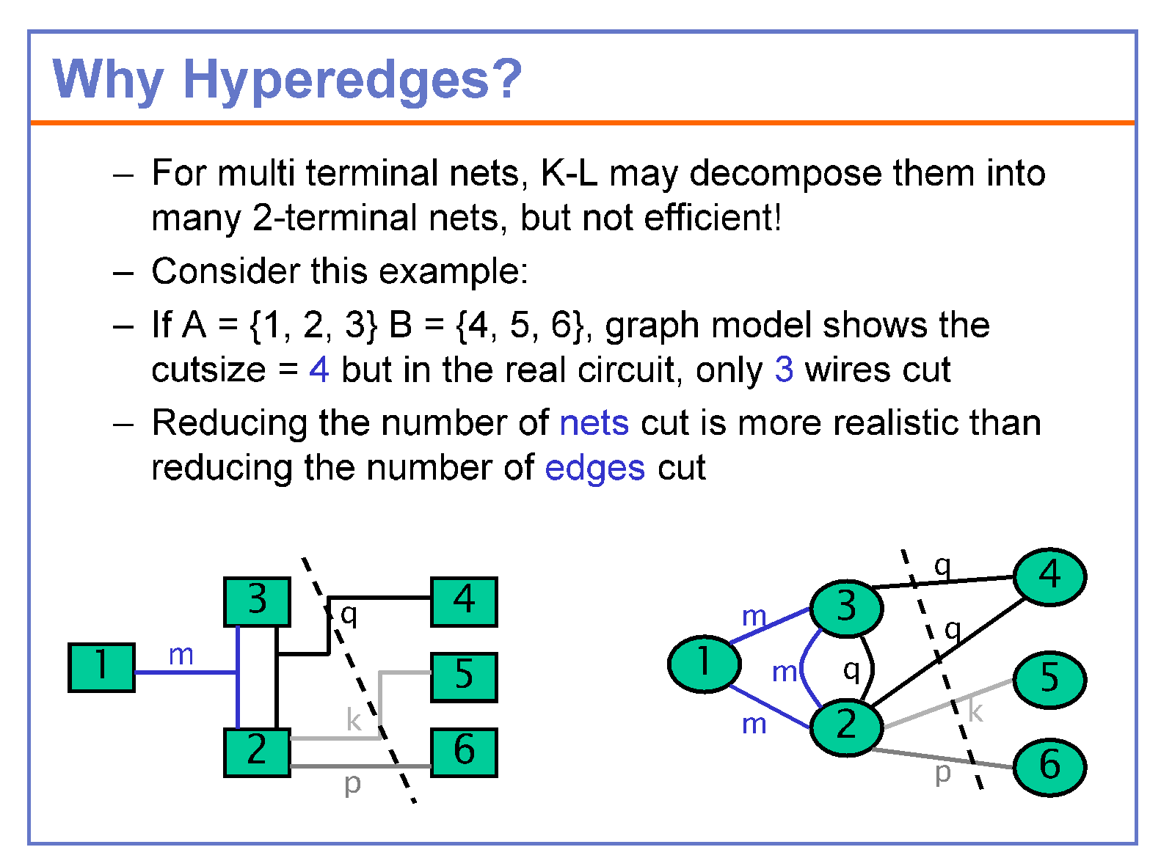

Slide 4
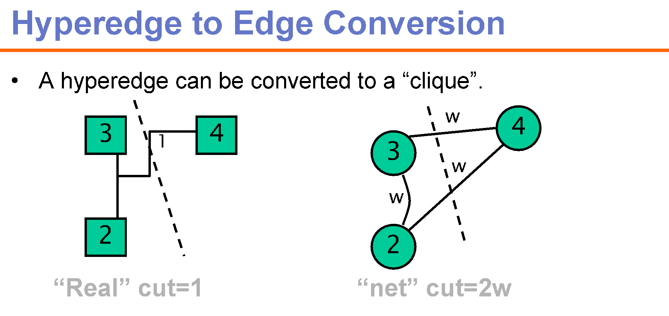

Slide 5
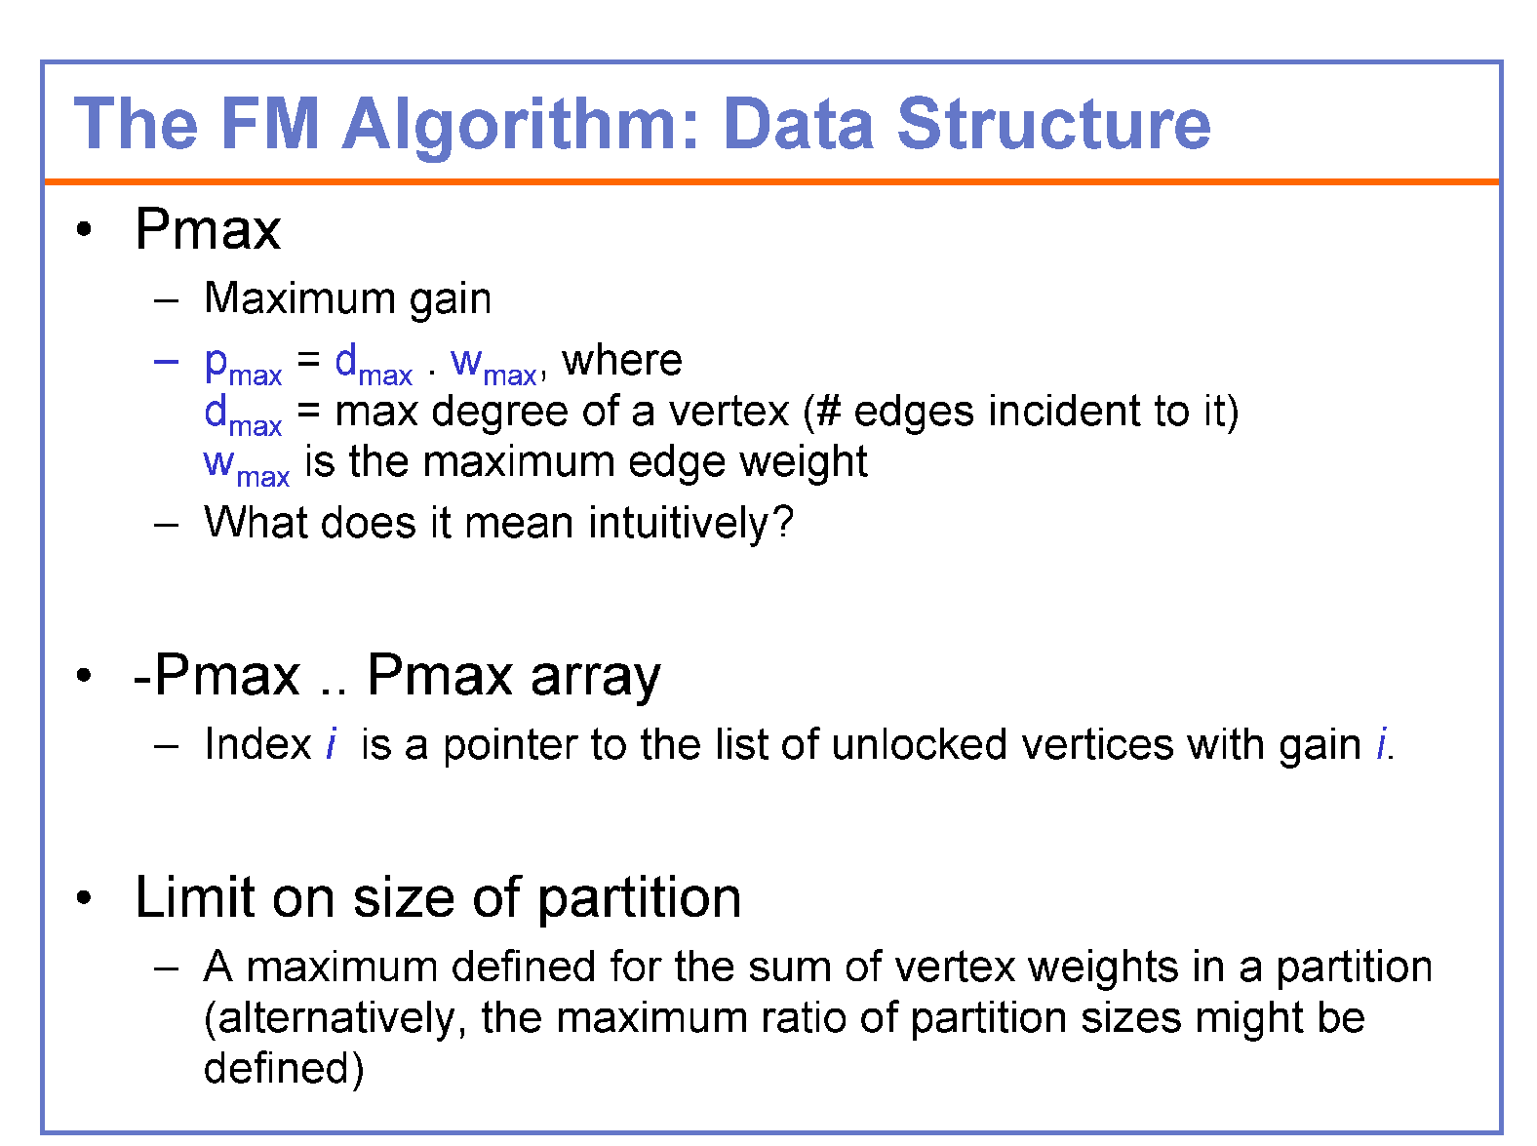

Slide 6
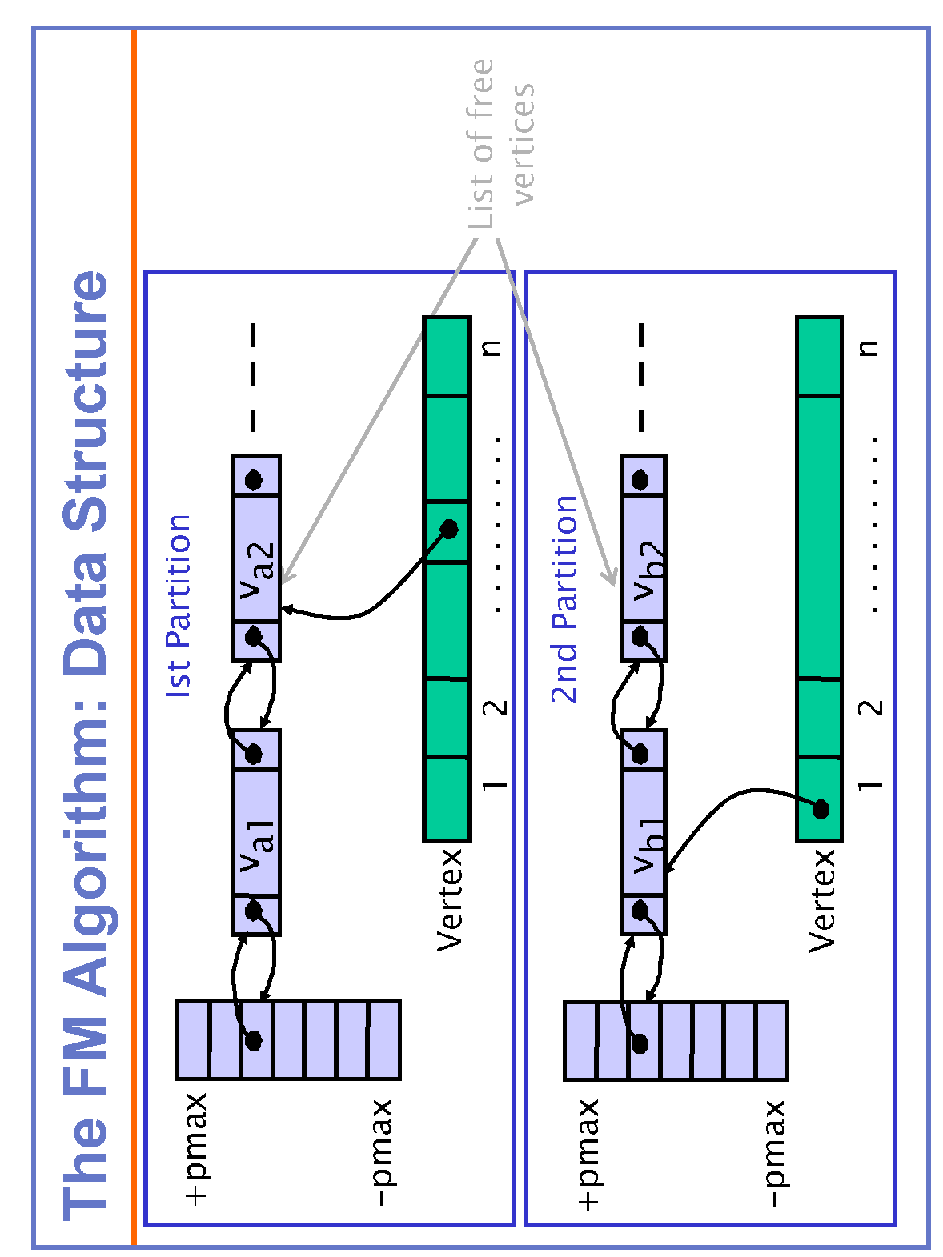
Each pointer in the array list A (or B) points to a linear list of unlocked vertices inside A (or B) with the corresponding gain

Slide 7

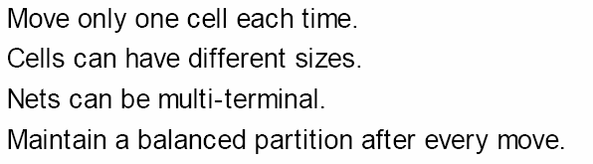
The FM Algorithm: Balanced Partition
•Definition. A maximum vertex weight W which satisfies the relation W >w(V)/2 + max_{vεV}{w(v)},
where w(v) = weight of vertex v,
w(V) = sum of the weights of all vertices
•Balanced partition {A|B} is one having a total vertex weight of at most W, i.e., w(A), w(B) <W.

Slide 8
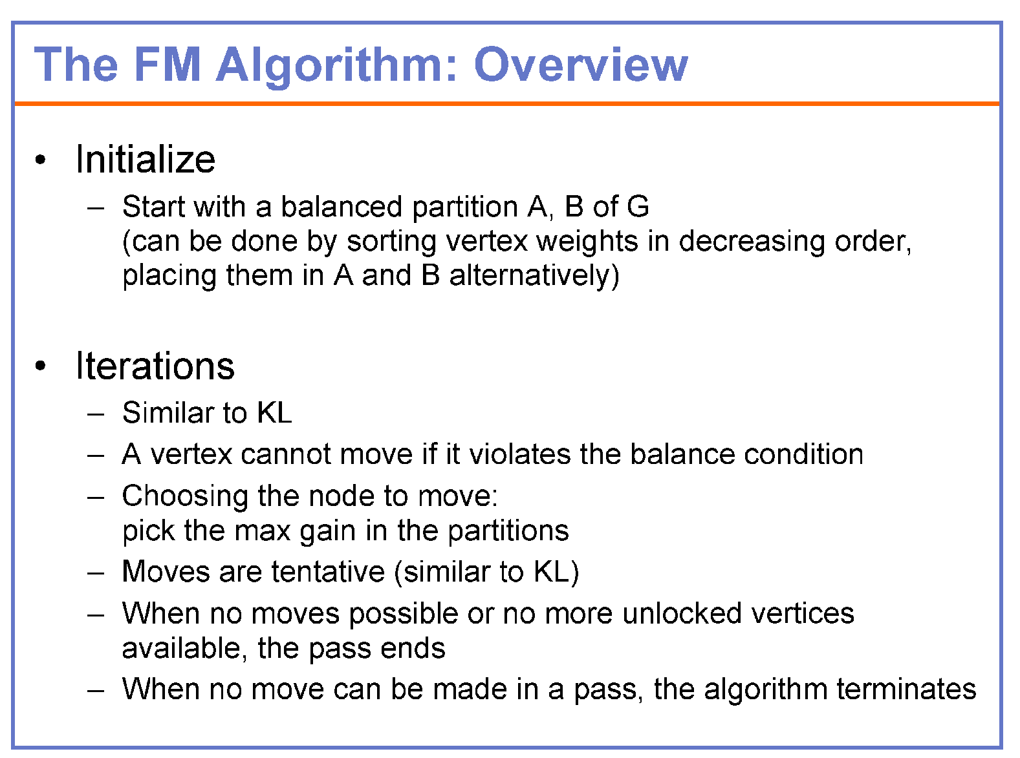

Slide 9
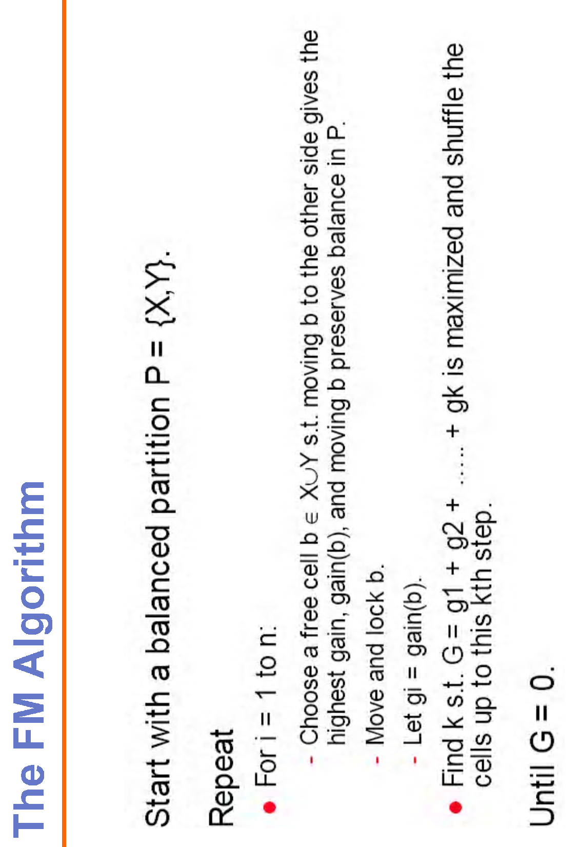
An initial balanced partition can be obtained by sorting vertex weights in decreasing order, and placing them in A and B alternatively

Slide 10
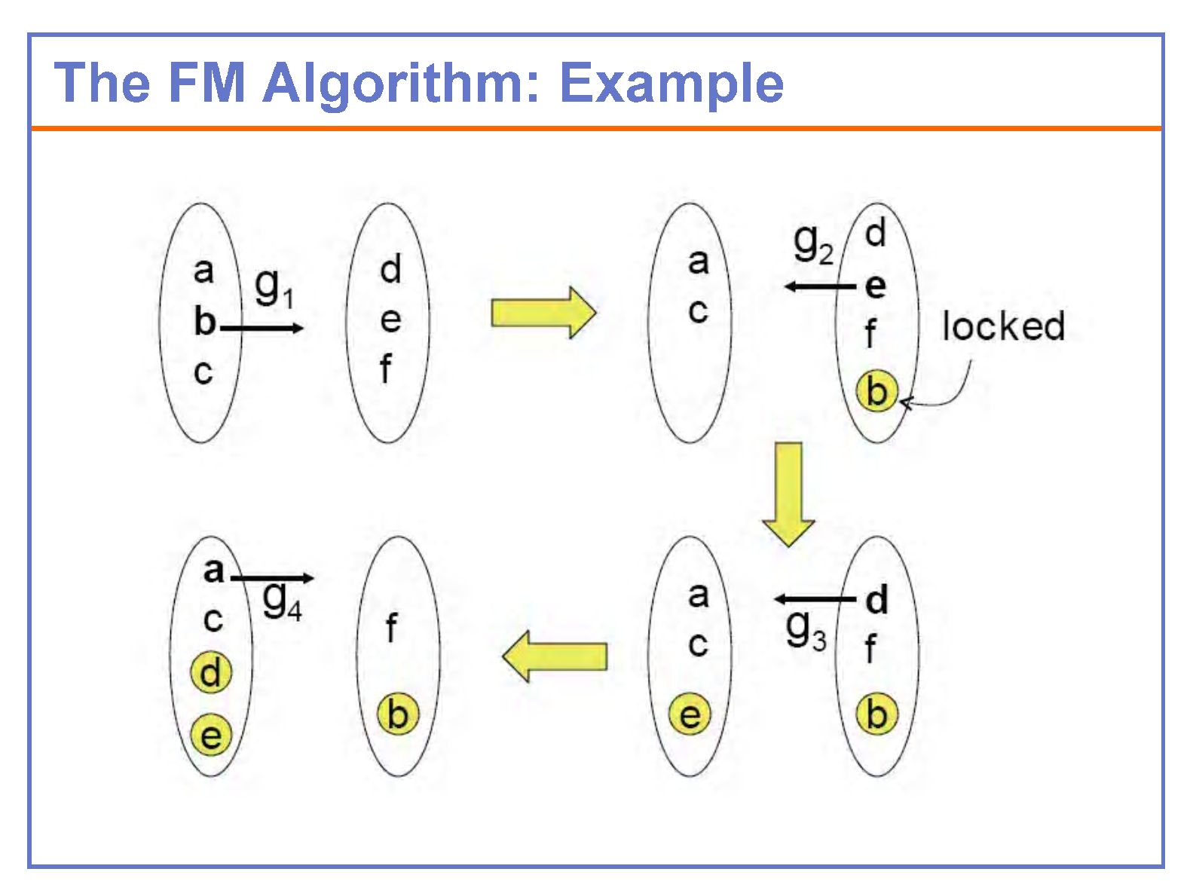

Slide 11
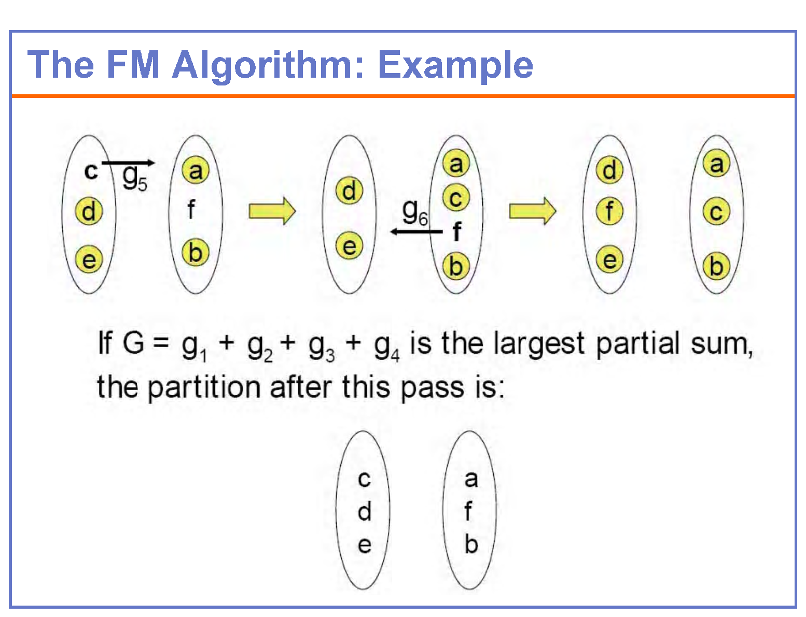

Slide 12
FM Algorithm: Time complexity
Data structures list A and B are initialized by traversing all hyperedges one by one
Consider the hyperedge e_{a}={M₁,M₂,…..,M_{d}}, when e₁, e₂, e₃,……,e_{a-1} are already visited
Let num(A) is the no of modules connected by e_{a} that are in A.
If num(A)=0, then gain of each module M_{i} in {M₁,M₂,…..,M_{d}} is decreased by w(e_{a}).
If num(A)=1, the gain of one module M_{i} in {M₁,M₂,…..,M_{d}} that is in A is increased by w(e_{a} ).
If num(A)>1, no action takes place unless num(B)= 0 or num(B)=1.
The same analysis holds for num(B).
Time spent for processing ea is O(d). Σd= the total number of terminals (t)
Finding the modules with maximum gain in list A and list B takes a constant time, if this value is maintained and updated while processing e_{a}.
Thus the time complexity of building data structures list A and list B is O(t+n), where n = the number of modules

Slide 13
FM Algorithm: Time complexity
In one pass, find a module with maximum gain using doubly linked pointers
Let a module M_{i} (in hyperedge e_{a}) is in A and is moved to B
Case 1: if all modules of e_{a} are in A (before moving M_{i}), the gain of all these modules will be increased by w(e_{a}).
Case 2: if all modules of e_{a} are in B (right after moving M_{i}), the gain of all these modules will be decreased by w(e_{a}).
Time taken to update the gain in each case is O(d_{a}), where d_{a} is the number of modules connected to e_{a}
Since each hyperedge will be considered twice (case 1 and 2), it takes time proportional to number of terminals to update the list
Total time is O(ct), where c= the number of passes (independent of t)

Slide 14
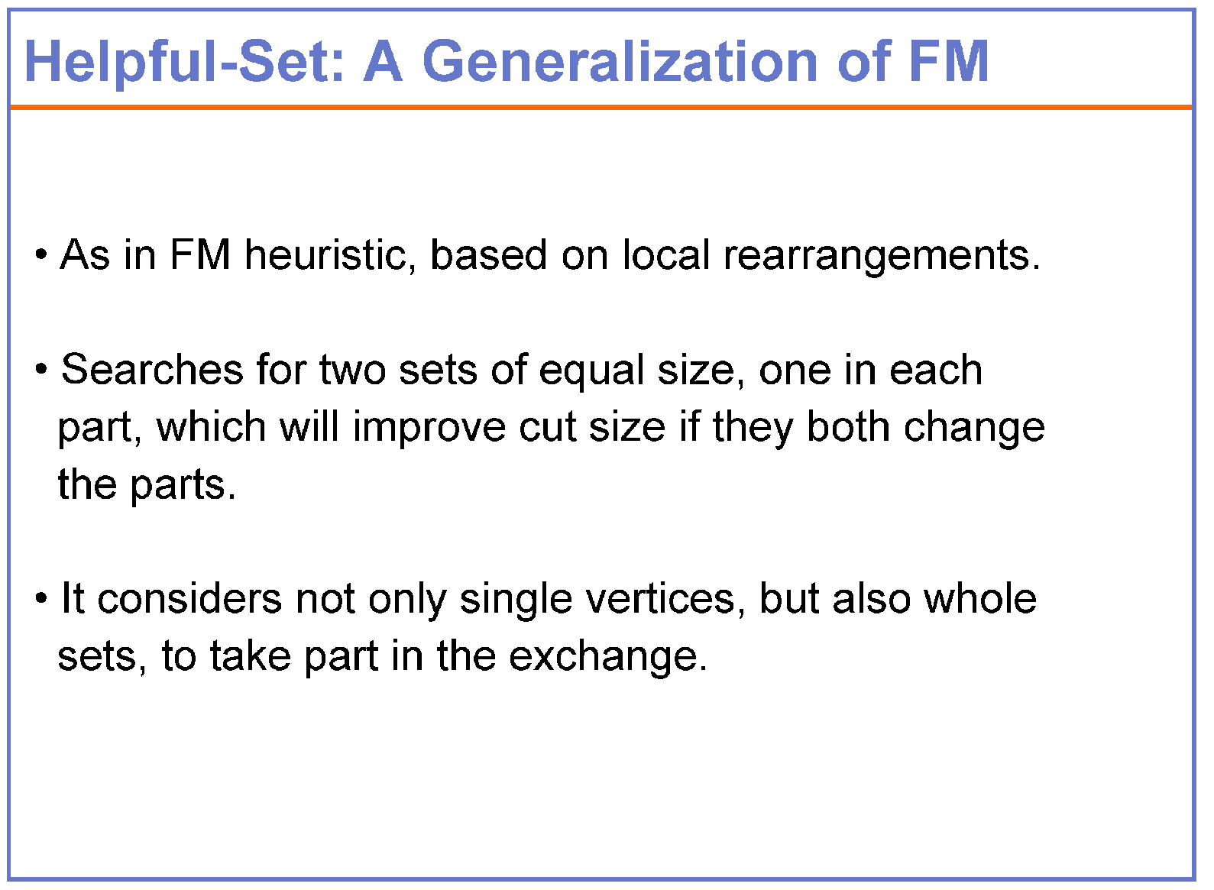

Slide 15
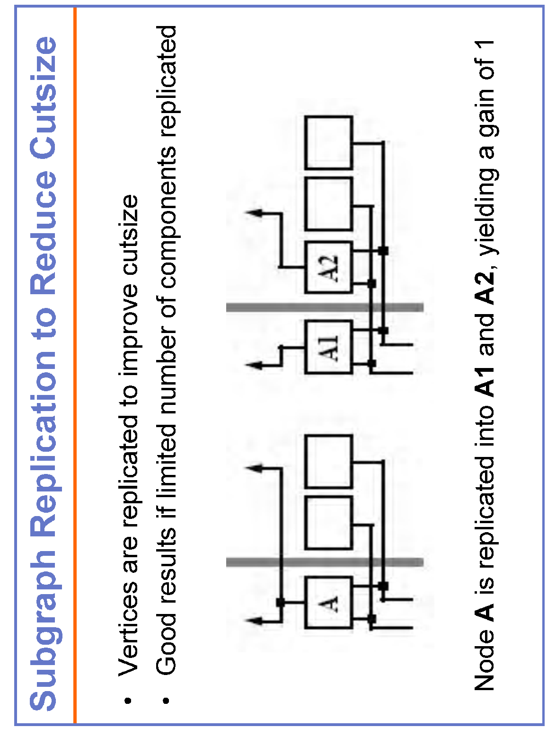
Partitioning using Replication

Slide 16
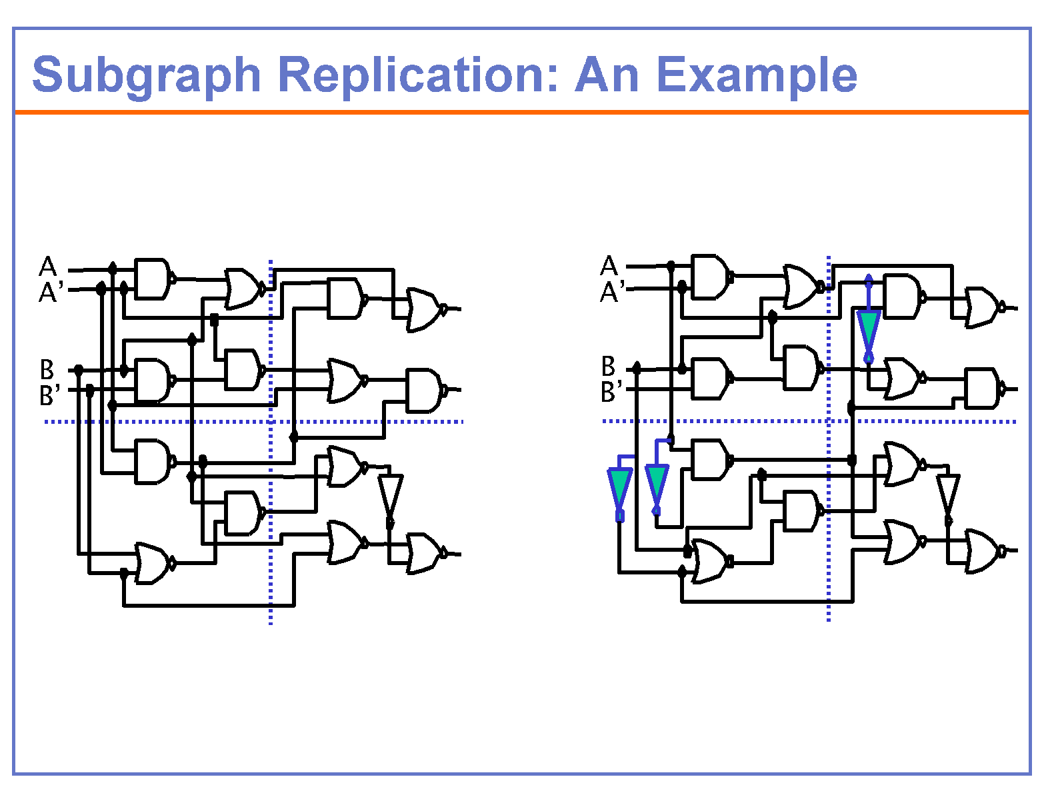

Slide 17
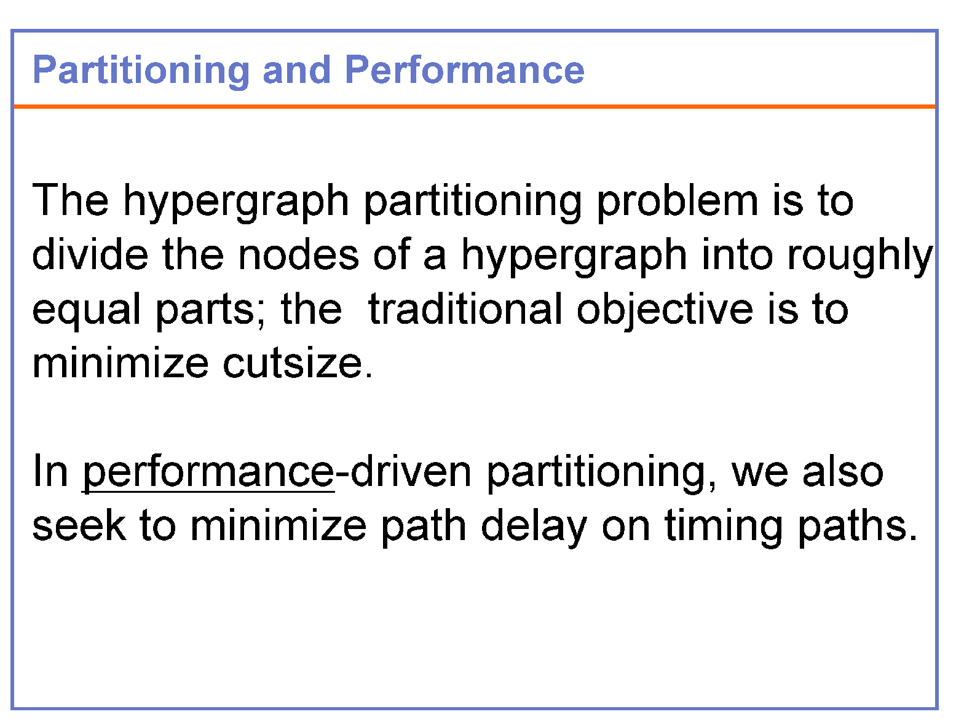

Slide 18
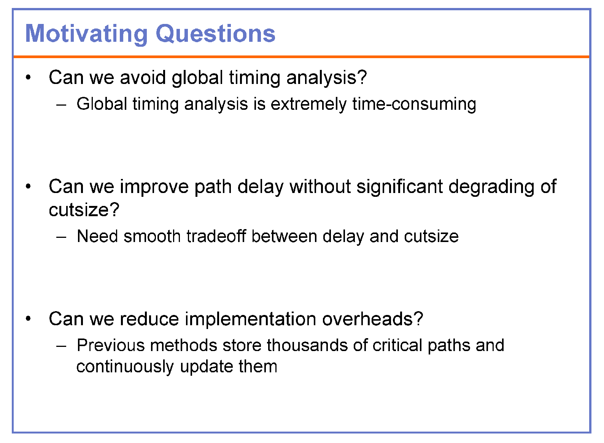

Slide 19
Partitioning and Delay Problem
If a critical path is cut many times by the partition, the delay on the path may be too large to meet the goals of the high performance systems
The design of a high performance system requires partitioning algorithms to reduce the cut size as well as to minimize the delay in critical paths

Slide 20
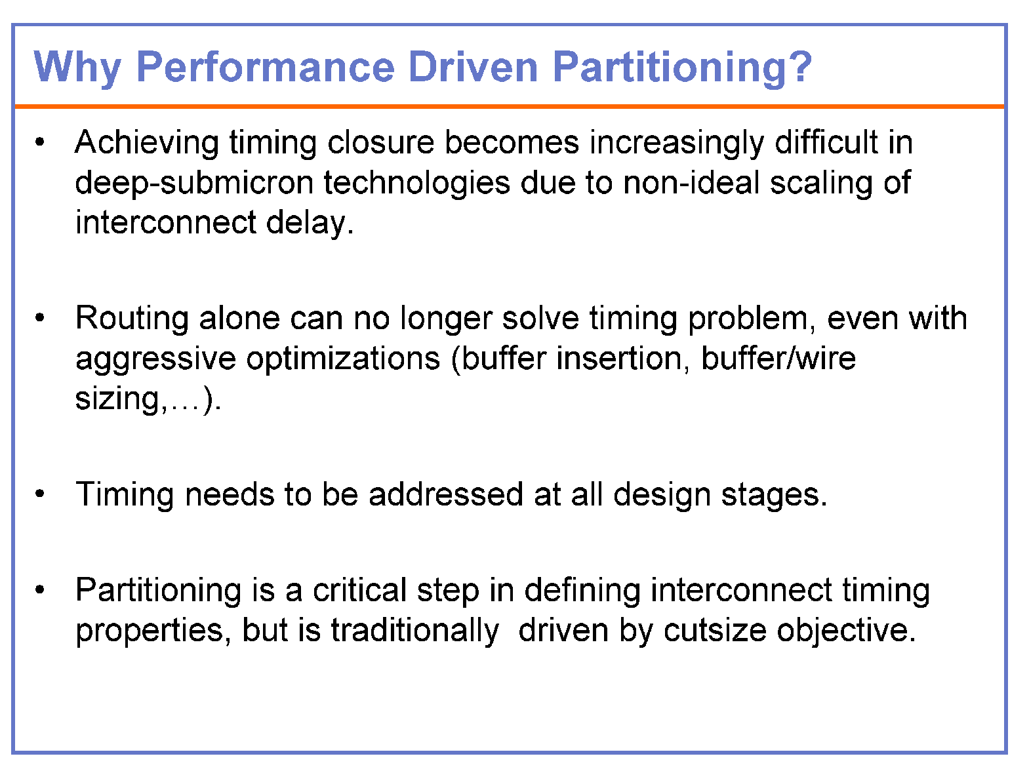

Slide 21
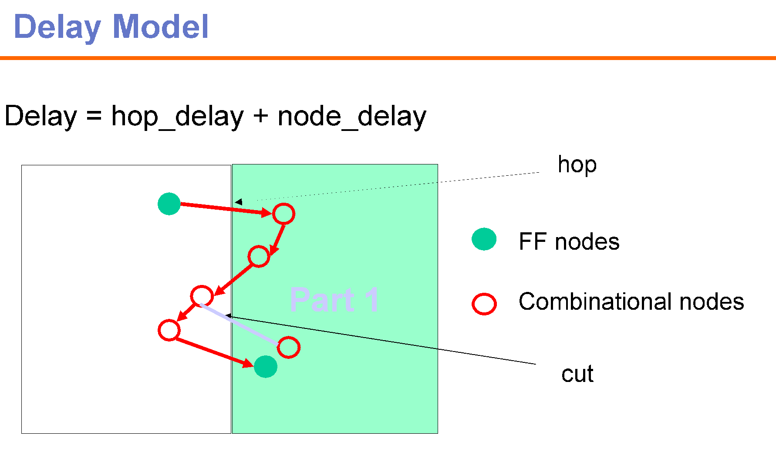

Slide 22
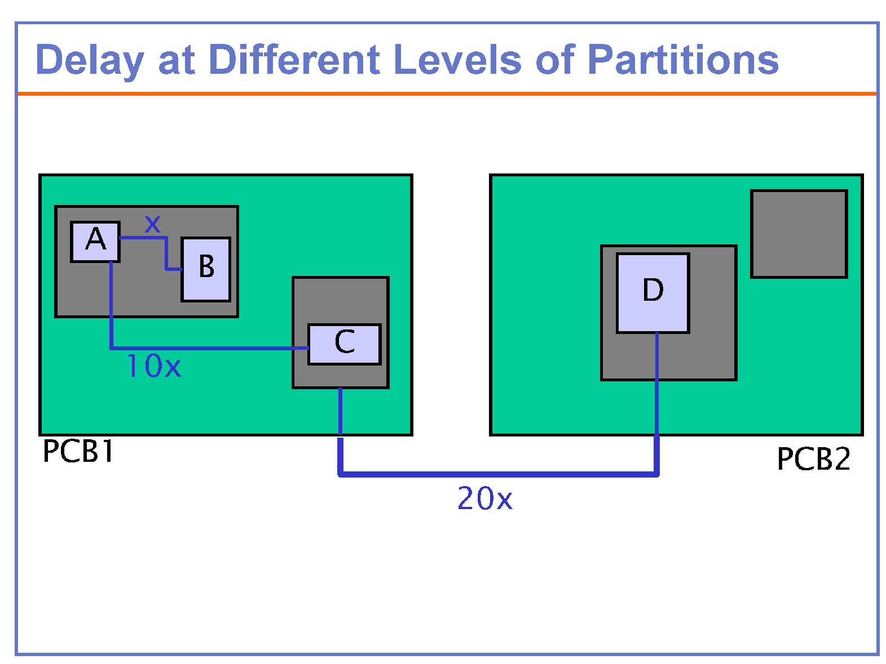
The on-board delay is three orders of magnitude larger than on-chip delay

Slide 23
